Slide 1
IMPORTANCE OF CYBER-SECURITY(24k-0737)
What We Will cover:
Introduction to Cybersecurity: CLICK HERE TO OPen
Types of Cyber Threats : CLICK HERE TO OPEN
Impact of Cyber Attacks : CLICK HERE TO OPEN
Cybersecurity for Individuals : CLICK HERE TO OPEN
Regulations and Compliance : CLICK HERE TO OPEN
Cybersecurity for Businesses CLICK HERE TO OPEN
Future Trends in Cybersecurity : CLICK HERE TO OPEN
Best Practices for Cybersecurity : CLICK HERE TO opEN
Conclusion : CLICK HERE TO OPEN
FOR VISUAL : CLICK
Used navigate button in above line
Used alt text in last slide
Used accessible color scheme in last slide

Slide 2
Introduction to Cybersecurity
In today's digital age, cybersecurity is more vital than ever. As we rely increasingly on technology, our exposure to digital attacks grows. That's why protecting our systems, networks, and data is paramount. Cybersecurity is all about keeping our information safe and private. But with threats becoming ever more sophisticated, staying informed about cybersecurity is no longer just an option - it's a necessity, whether you're an individual or an organization.

Slide 3
Types of Cyber Threats
Cyber threats come in many disguises. Malware, for instance, is malicious software designed to wreak havoc or sneak into your system undetected. Then there's phishing, where scammers manipulate you into divulging sensitive info. Ransomware is particularly sinister, locking down your data and holding it hostage until you pay up. And denial-of-service attacks overwhelm systems, grinding them to a halt. To shield yourself from these threats, understanding their tactics is key. By recognizing the enemy, you can build a stronger defense and safeguard your digital world.

Slide 4
Impact of Cyber Attacks
Cyber attacks can be devastating. For individuals, the fallout can include identity theft, compromised personal info, and financial ruin. Businesses face even greater stakes: operations grind to a halt, recovery costs skyrocket, and reputations are tarnished. The aftermath can be crippling. A single breach can dismantle customer trust and undermine years of hard-earned credibility. The risks are real, and the consequences are dire. That's why investing in top-notch cybersecurity is no longer optional – it's essential for protecting what matters most.

Slide 5
Cybersecurity for Individuals
Your online safety starts with you. Protecting personal info and accounts requires proactive steps. Begin with essentials: strong, unique passwords and two-factor authentication. Be wary of suspicious emails and links – verification is key. Don't overlook social media privacy settings and regular software updates.
By taking control, you significantly minimize cyber risk. Educate yourself, stay vigilant, and shield your digital life. Empowered individuals equal a safer online community."

Slide 6
Regulations and Compliance
Protecting sensitive information is critical. That's why regulations like GDPR and HIPAA outline specific cybersecurity requirements. By complying, organizations avoid legal repercussions and earn the trust of customers and stakeholders.
Compliance is more than a checkbox – it's a promise to prioritize data protection. By embracing these frameworks, businesses demonstrate accountability, integrity, and a customer-centric approach.

Slide 7
Cybersecurity for Businesses
For businesses, cybersecurity is critical to protect sensitive data and maintain customer trust. Implementing strong security measures helps safeguard intellectual property and financial information. Regular security assessments, employee training, and incident response plans are essential components of a comprehensive cybersecurity strategy. A proactive approach can mitigate risks and enhance organizational resilience.

Slide 8
Best Practices for Cybersecurity
Adopting best practices is essential for enhancing cybersecurity. These include regular software updates, employee training, using strong passwords, and conducting vulnerability assessments. Implementing multi-layered security measures, such as firewalls and antivirus software, can further protect against cyber threats. A proactive approach to cybersecurity helps create a secure digital environment.

Slide 9
Future Trends in Cybersecurity
The future of cybersecurity is shaped by evolving technologies and emerging threats. Trends such as Artificial Intelligence (AI) in threat detection, increased use of cloud security, and the growing importance of zero-trust architectures are on the rise. Staying informed about these trends is crucial for organizations and individuals to adapt their cybersecurity strategies effectively.

Slide 10
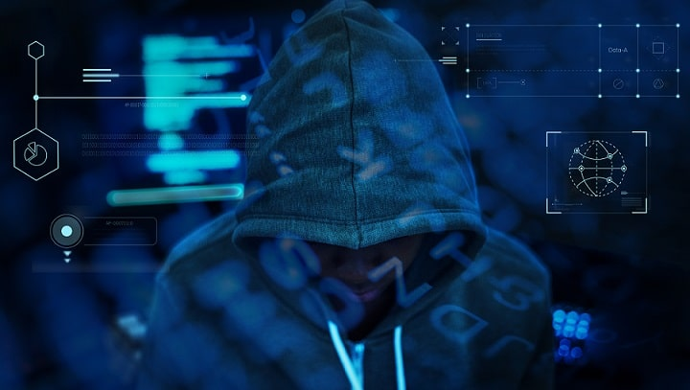
Conclusion
In today's digitally connected world, cybersecurity is no longer optional – it's imperative. As threats escalate, individuals and organizations must prioritize protection. Understanding the threat landscape, potential impacts, and best practices is crucial.
Effective cybersecurity safeguards more than just assets; it fosters trust, confidence, and resilience. By investing in robust security measures, we protect not only our information but also our way of life.
In conclusion, cybersecurity is the backbone of a secure digital future. Let's prioritize it.

Slide 11

Short clip on CYBER-SECURITY

